Slide 1
UNIT-1
Overview of Scrum framework

Slide 2
Table of Content
What is Scrum framework.
Scrum Framework Overview.
Scrum Methodology
Scrum Roles,Event and Artifacts.
Setting Up a Scrum Board and Backlog by using tools like Jira or Trello.
Daily Standup (Daily Scrum)
Sprint Retrospective

Slide 3
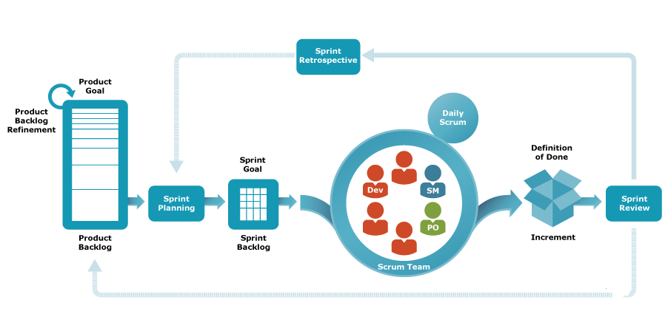
What is Scrum framework
The Scrum framework is an Agile methodology that helps teams work collaboratively on complex projects.
Primarily software development,
but it can be applied to other fields.
Scrum promotes iterative progress, adaptability, and continuous
improvement.

Slide 4
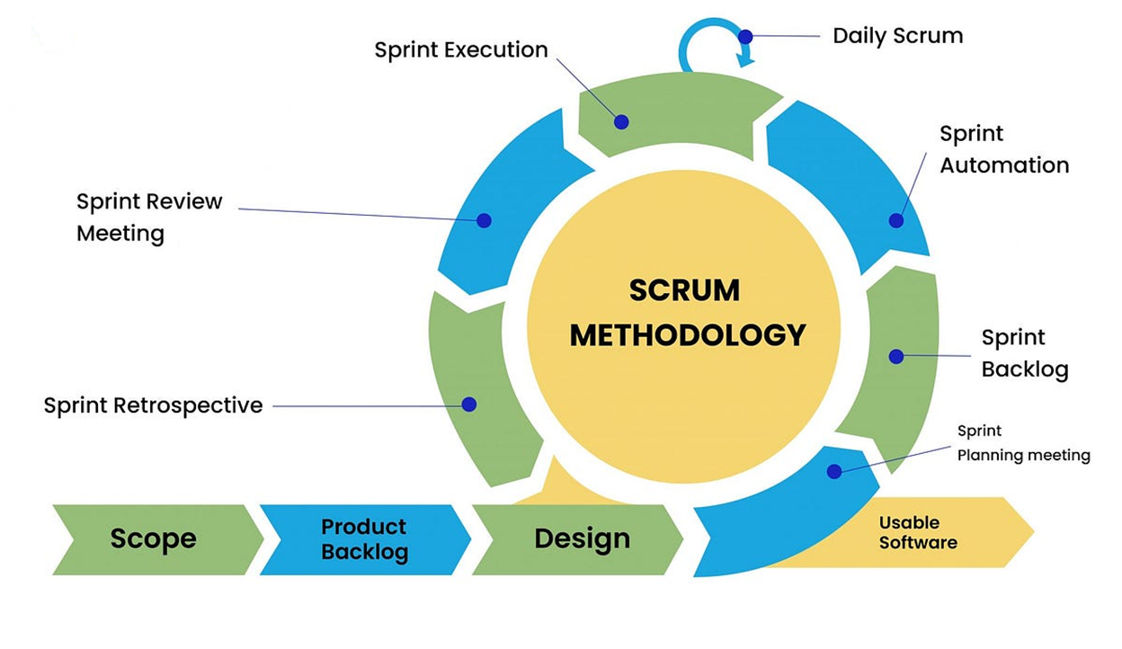
Scrum Methodology

Slide 5
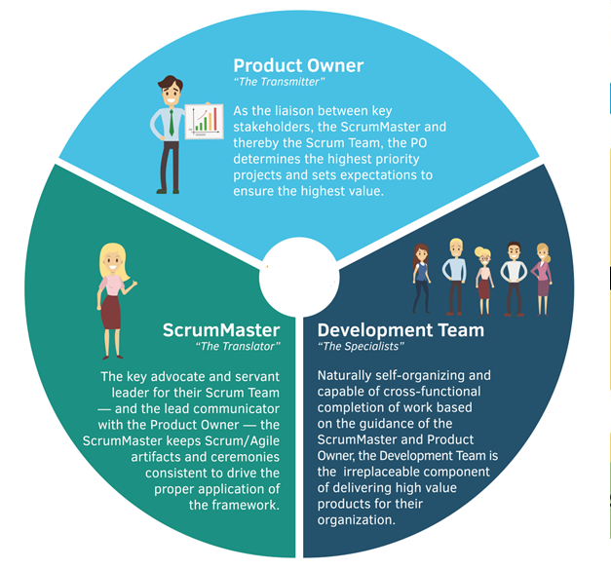
Scrum is organized into roles, events, and artifacts:-
Roles:
Product Owner: Manages the product backlog and ensures the team works on the most valuable features.
Scrum Master: Facilitates Scrum events, removes blockers, and ensures the team follows Scrum practices.
Development Team: The group of professionals working to complete the product increment.

Slide 6
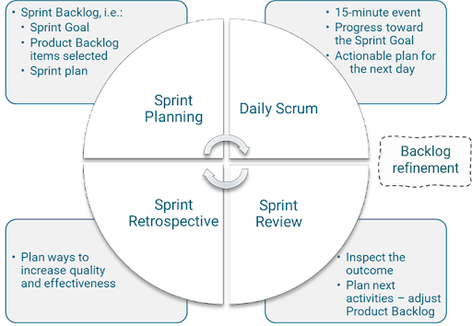
Events:
Sprint: A time-boxed iteration (usually 2–4 weeks).
Sprint Planning: A meeting to plan the tasks for the upcoming sprint.
Daily Standup (Daily Scrum): A quick meeting (usually 15 minutes)
Sprint Review: A meeting to demonstrate the work completed during the sprint.
Sprint Retrospective: A meeting to reflect on the sprint and identify improvements for the next one.

Slide 7
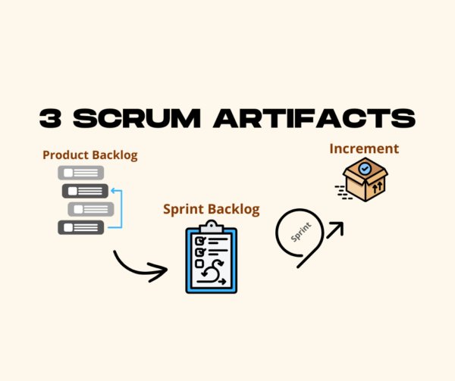
Artifacts:
Product Backlog: A list of all desired work on the product, maintained by the Product Owner.
Sprint Backlog: A subset of the product backlog, consisting of tasks that the team commits to complete in the sprint.
Increment: The working product increment that is delivered at the end of each sprint.

Slide 8
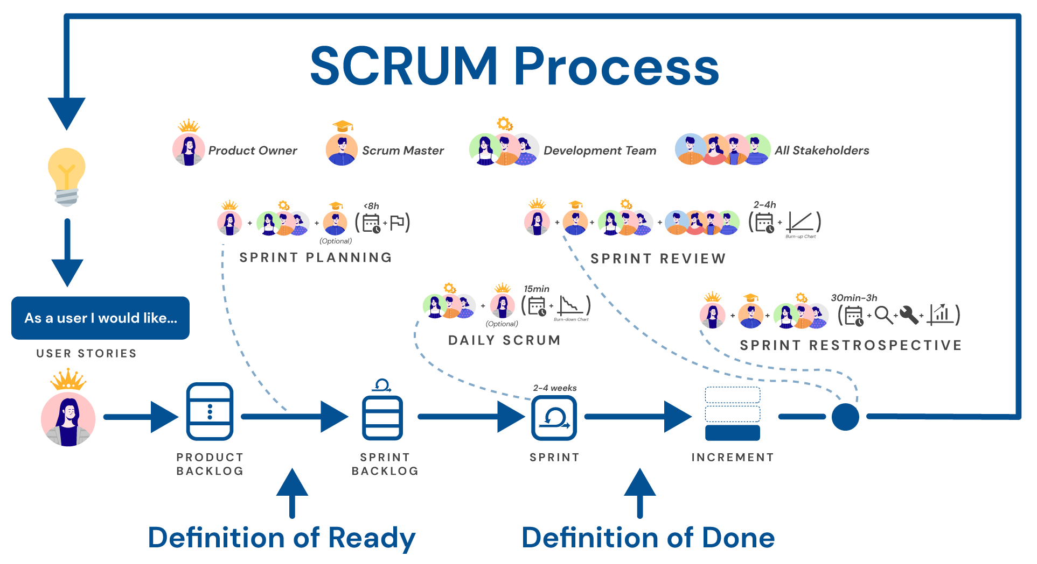
Setting Up a Scrum Board and Backlog

Slide 9
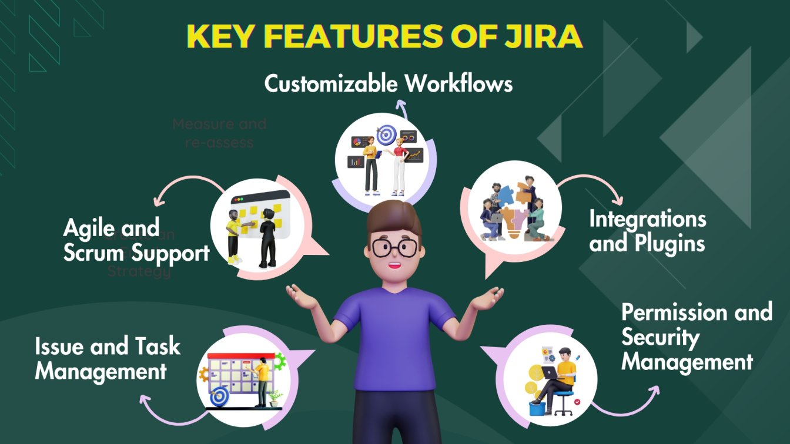
Tools like Jira or Trello can be used to manage these artifacts:
Jira:
Create a project: In Jira, start by creating a Scrum project.
Set up the Backlog: The Product Owner adds user stories or features to the product backlog.
Sprint Planning: During Sprint Planning, the team moves items from the backlog.
Scrum Board: Create a Scrum board to visualize progress.
Monitor Progress: Use Jira's reporting features to track velocity.

Slide 10
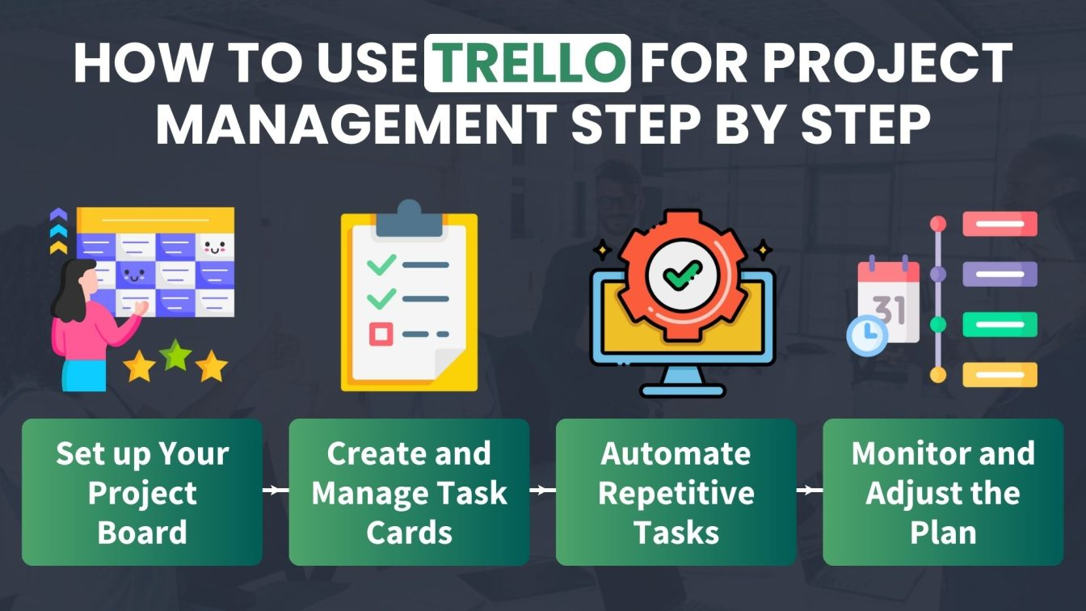
Trello:
Create Boards: Set up a Trello board for each sprint
Create Cards: Add tasks or user stories as cards.
Move Cards: As work progresses
Power-Ups: Trello offers Power-Ups for reporting .

Slide 11
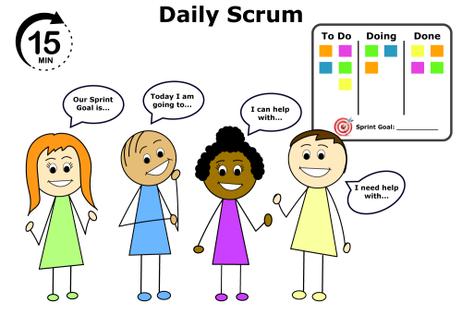
Daily Standup (Daily Scrum)
The Daily Standup is a quick, 15-minute meeting, usually held at the same time and place every day.
The format typically follows these three questions:-
What did I do yesterday? (What tasks were completed?)
What will I do today? (What tasks will I work on today?)
Do I have any blockers? (Are there any obstacles that need to be addressed?)

Slide 12
